Slide 1

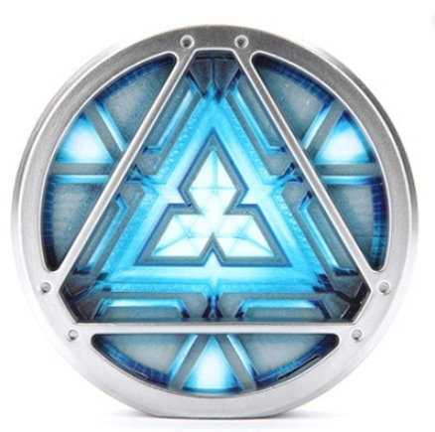
IronMan
Mood Light
Team : 신과 함께
신재형, 김주현, 양재혁

Slide 2
INDEX
-
Motivation & Goal
-
Value of system
-
Overall architecture
-
Hardware components & role
-
Important features
-
Progress & plan
-

Slide 3


Motivation & Goal
Maximize the convenience of mood light by using the modern trend hand gesture
Measure dust in the room easily

Slide 4
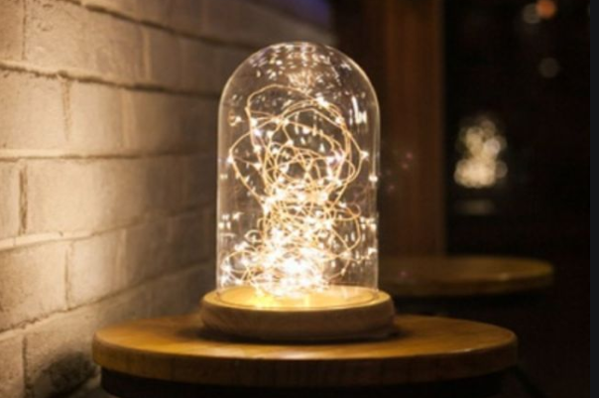
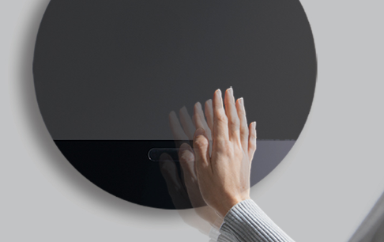
Value of system
Practical aspects
-dust measurement
- Creating comfortable mood
Creative aspects
- Control light with hand gesture

Slide 5
Overall architecture
Idea Sketch & Circuit

Slide 6
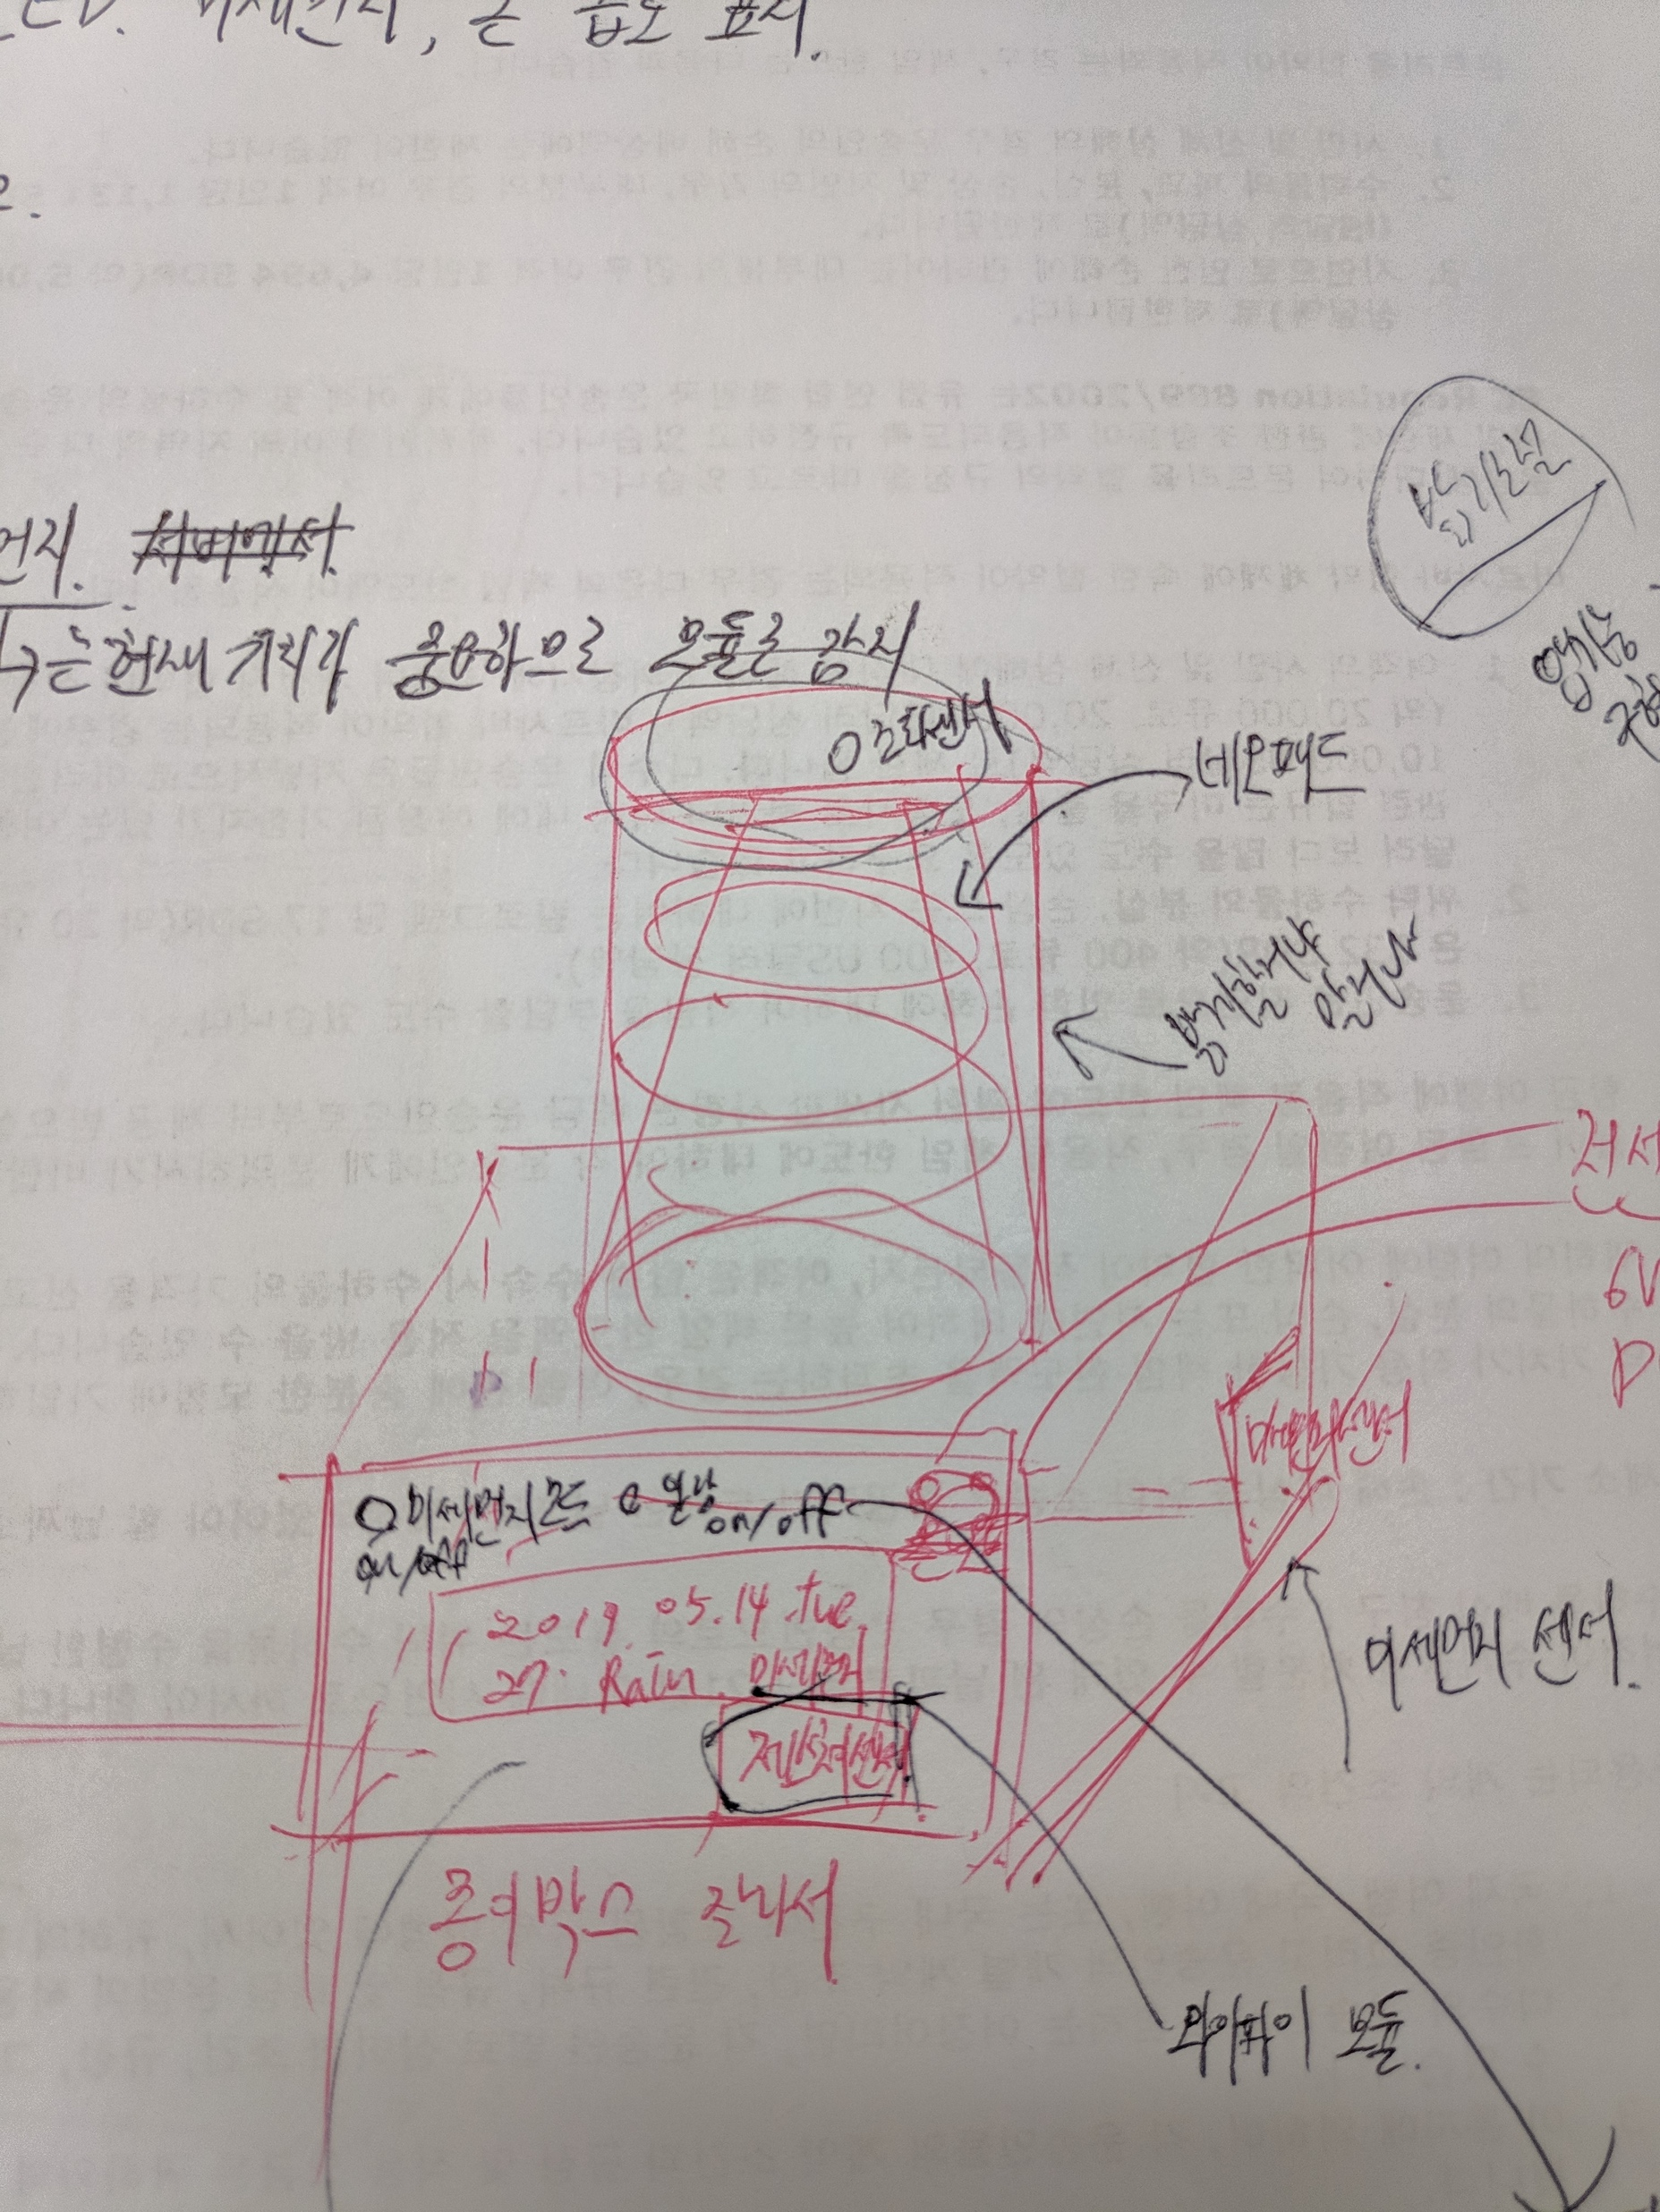
Overall architecture
IronMan MoodLight
Circuit diagram
Schemic

Slide 7
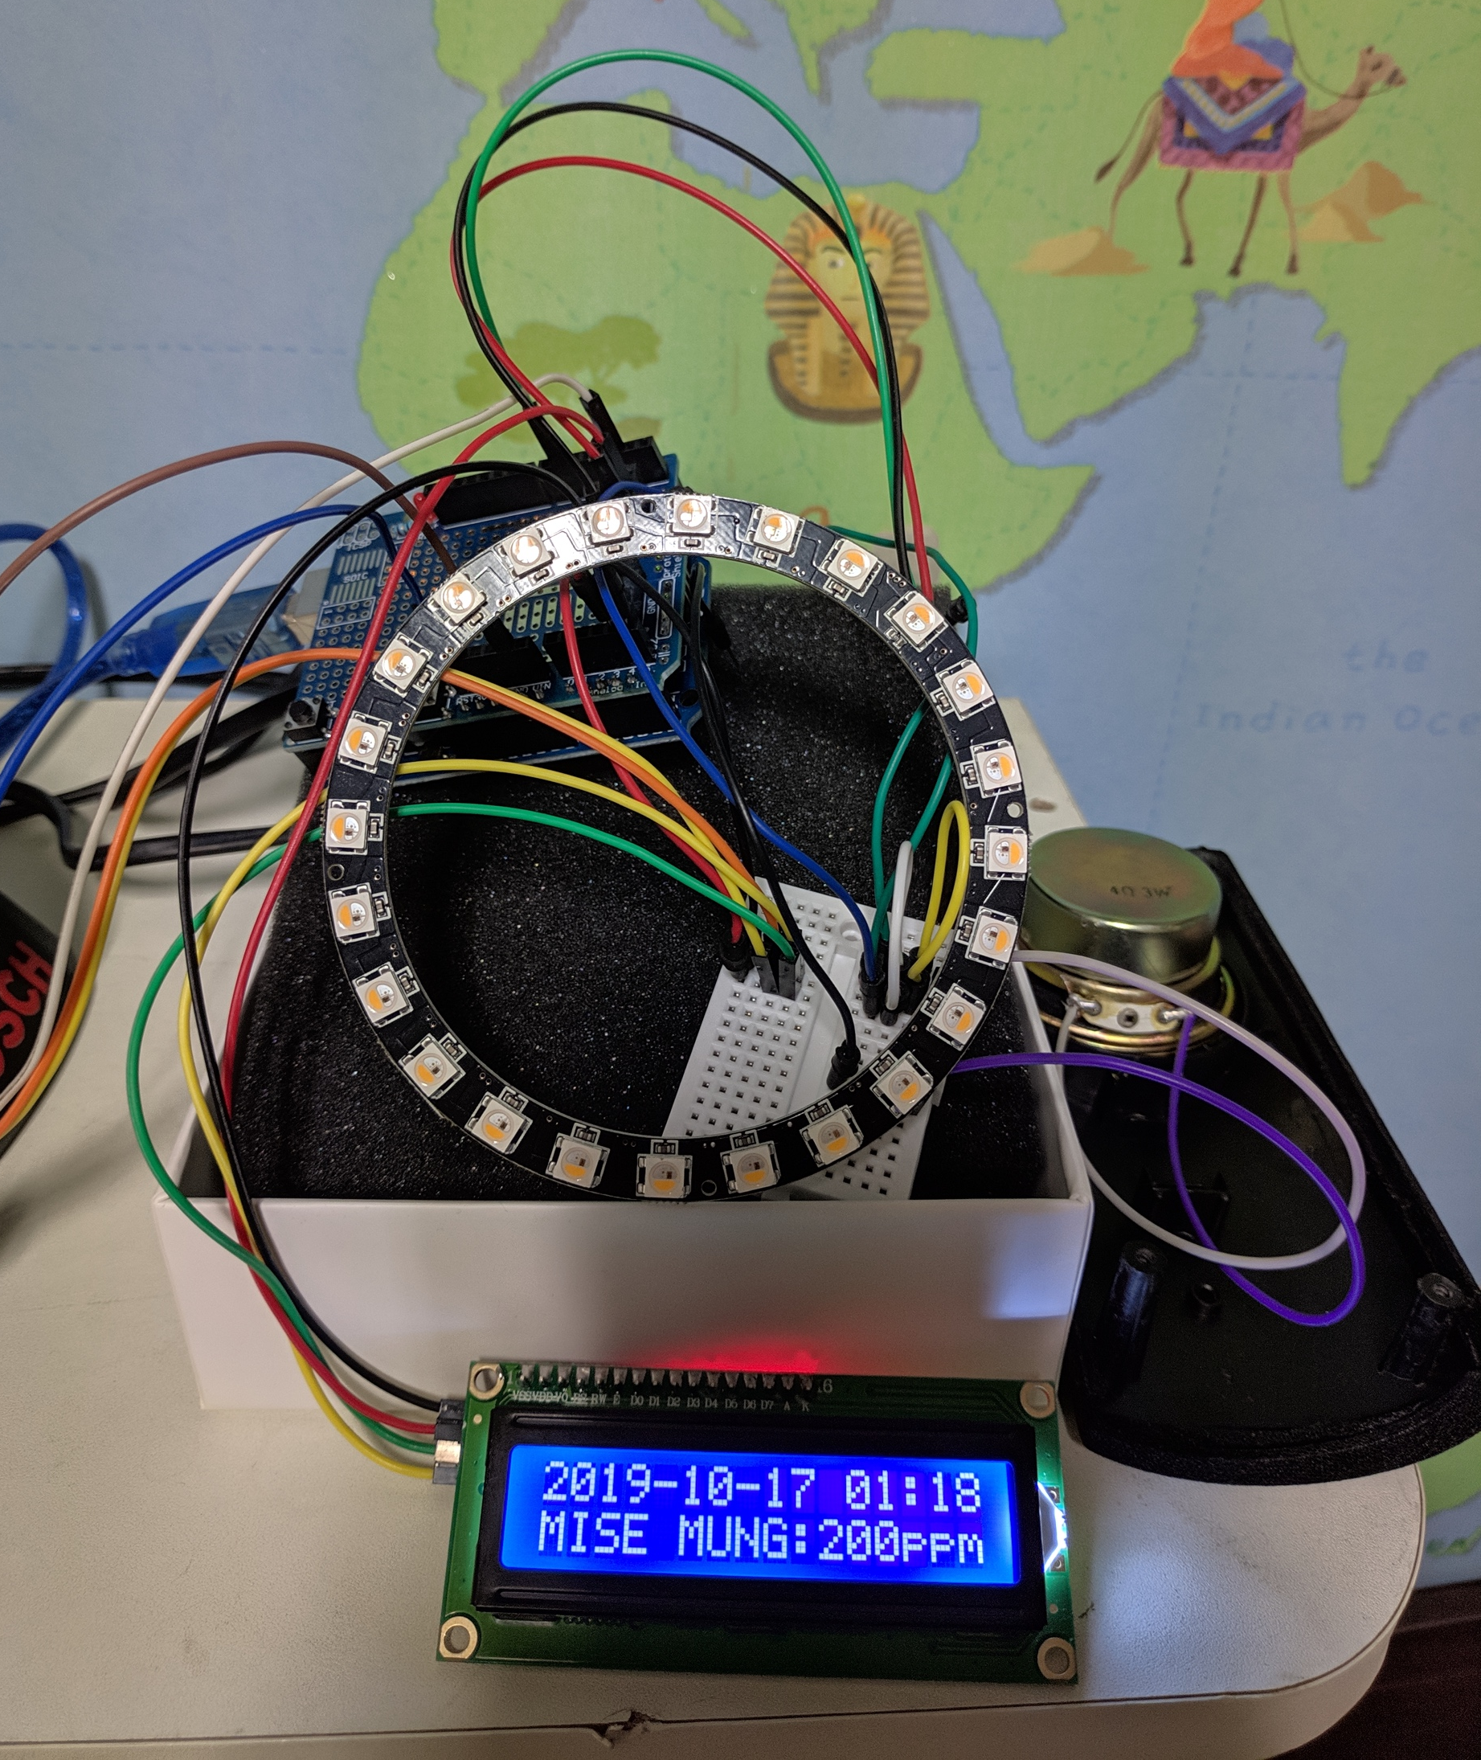
Overall architecture
IronMan MoodLight
Circuit diagram
Schemic

Slide 8
Hardware
Components
Arduino Uno
Neo pixel ring 24
Gesture Sensor APDS-9960
Fine dust sensor
Box
Mood light case
LCD module
Bluetooth module HC06
Speaker

Slide 9
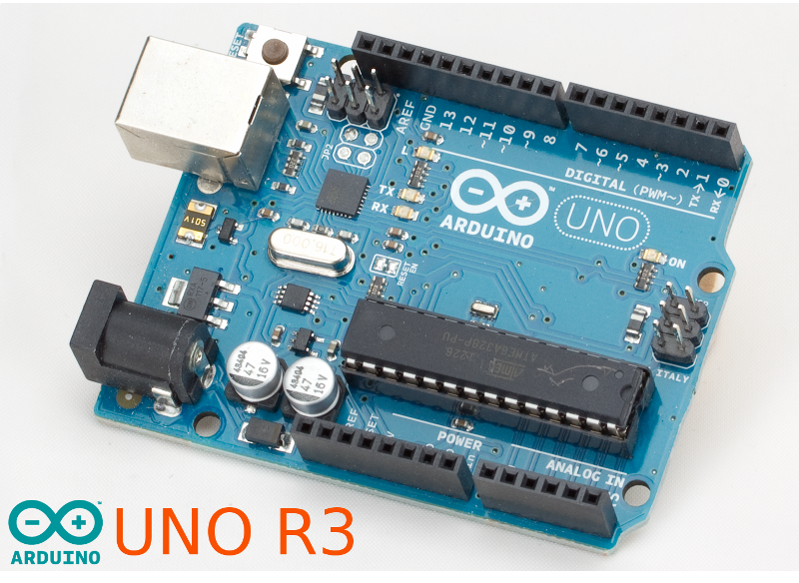
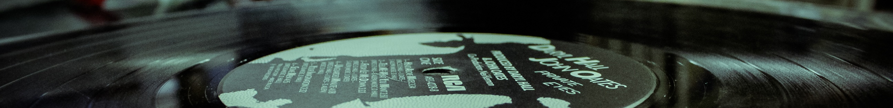
Components
IronMan MoodLight
Hardware
Arduino Uno
-Input-output and power supply

Slide 10
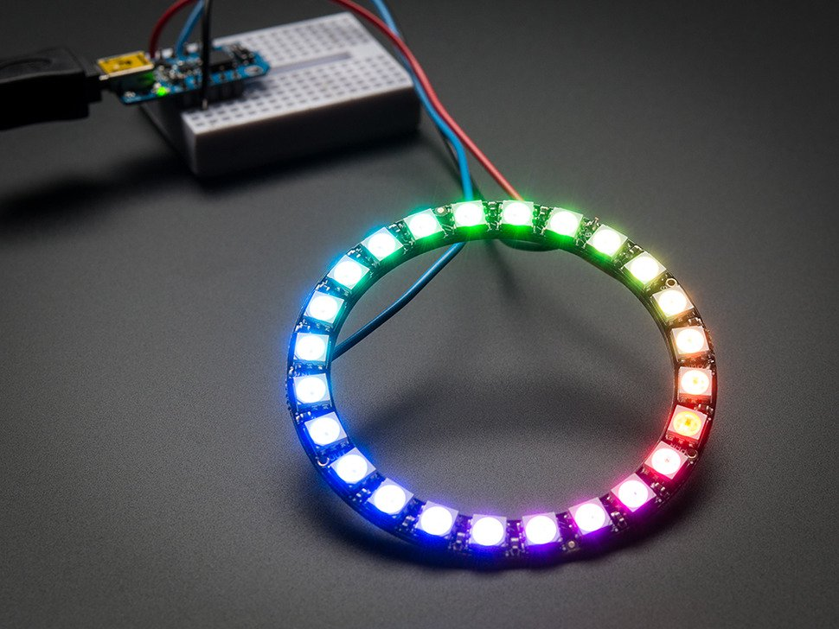
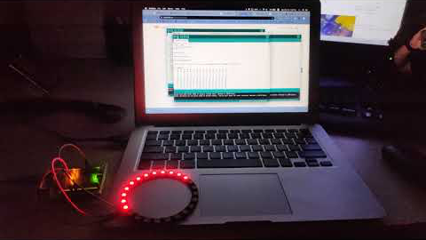
Components
IronMan MoodLight
Hardware
Neo pixel ring 24
-Light source of Mood Light

Slide 11
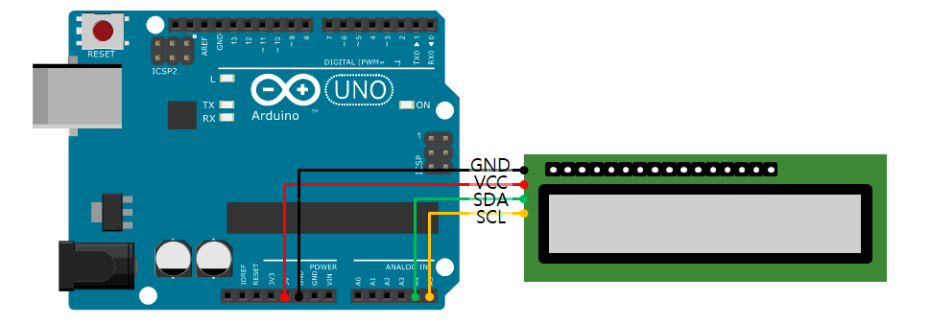
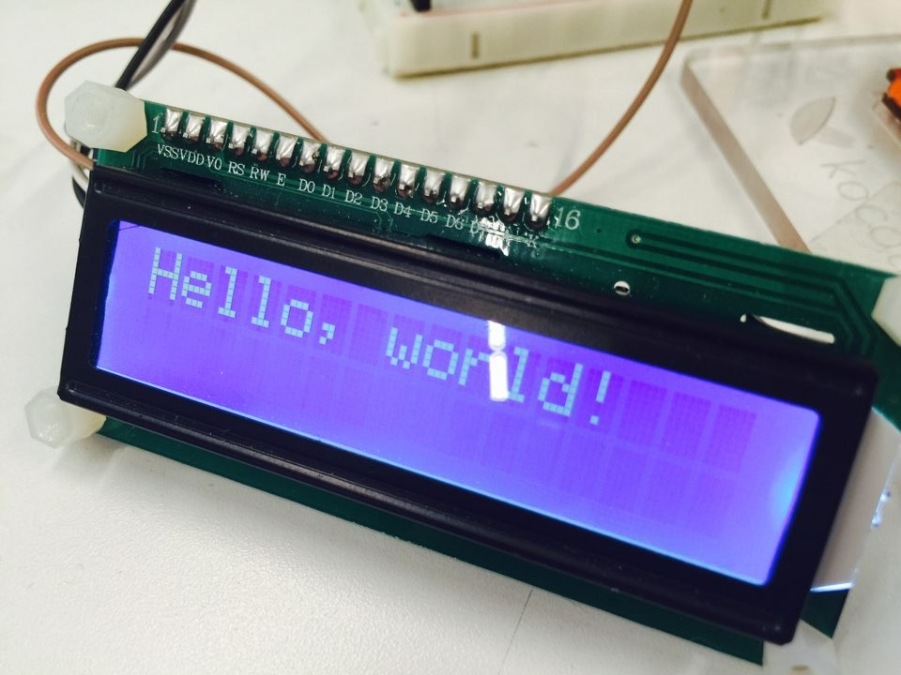
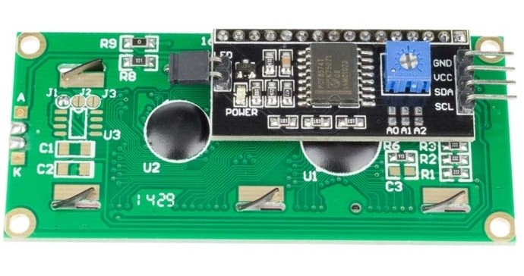
Components
IronMan MoodLight
Hardware
LCD Module
-Displaying concentration of fine dust and current time

Slide 12
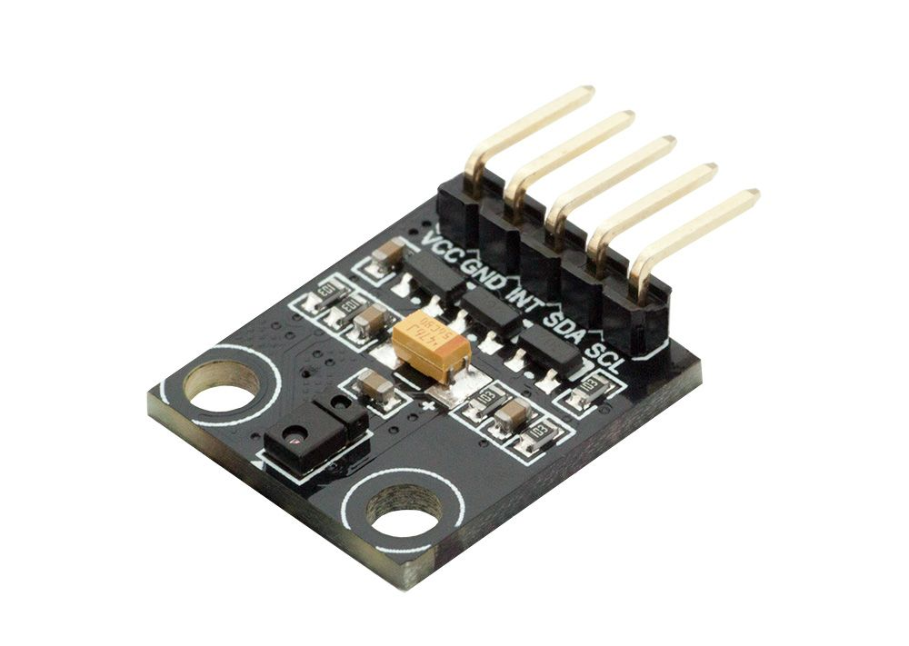
Components
IronMan MoodLight
Hardware
Gesture Sensor APDS-9960
-Sensing gesture and illumination sensor

Slide 13
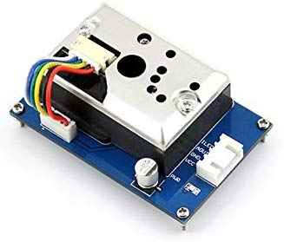
Components
IronMan MoodLight
Hardware
Dust sensor GP2Y1014AU0F
-Sensing fine dust

Slide 14
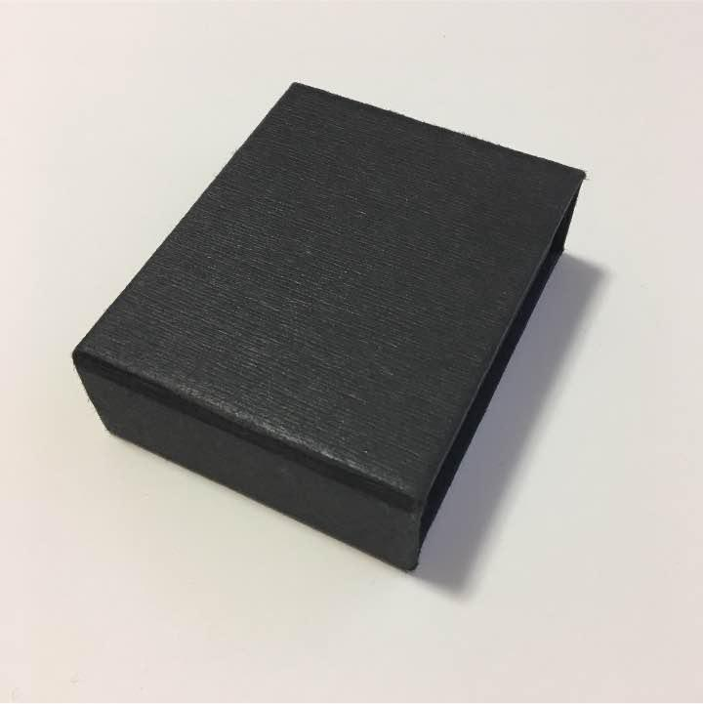
Components
IronMan MoodLight
Hardware
Exterior box
-protect wire and Uno

Slide 15
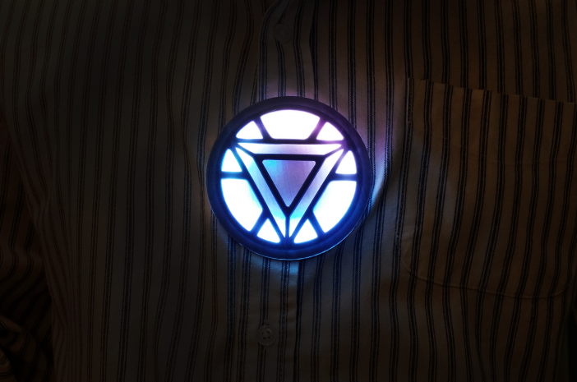
Components
IronMan MoodLight
Hardware
Mood Light case (3D printing)
-Design and protection

Slide 16
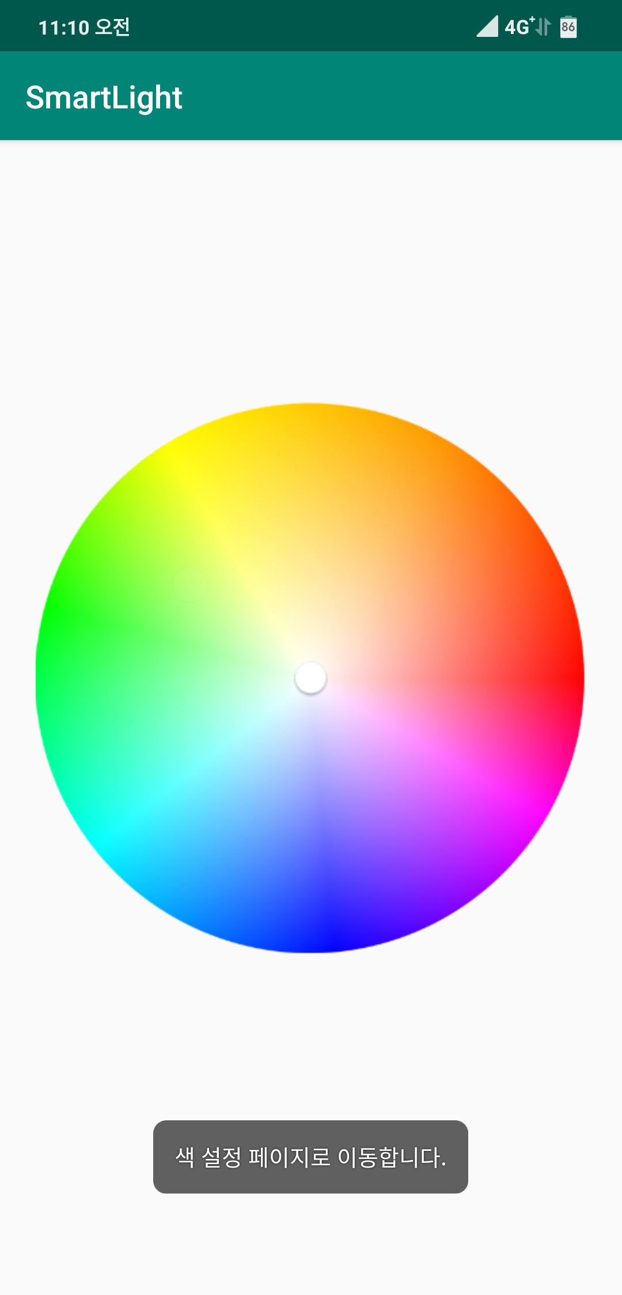
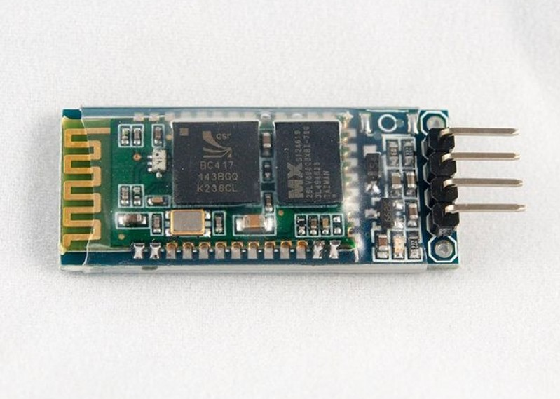
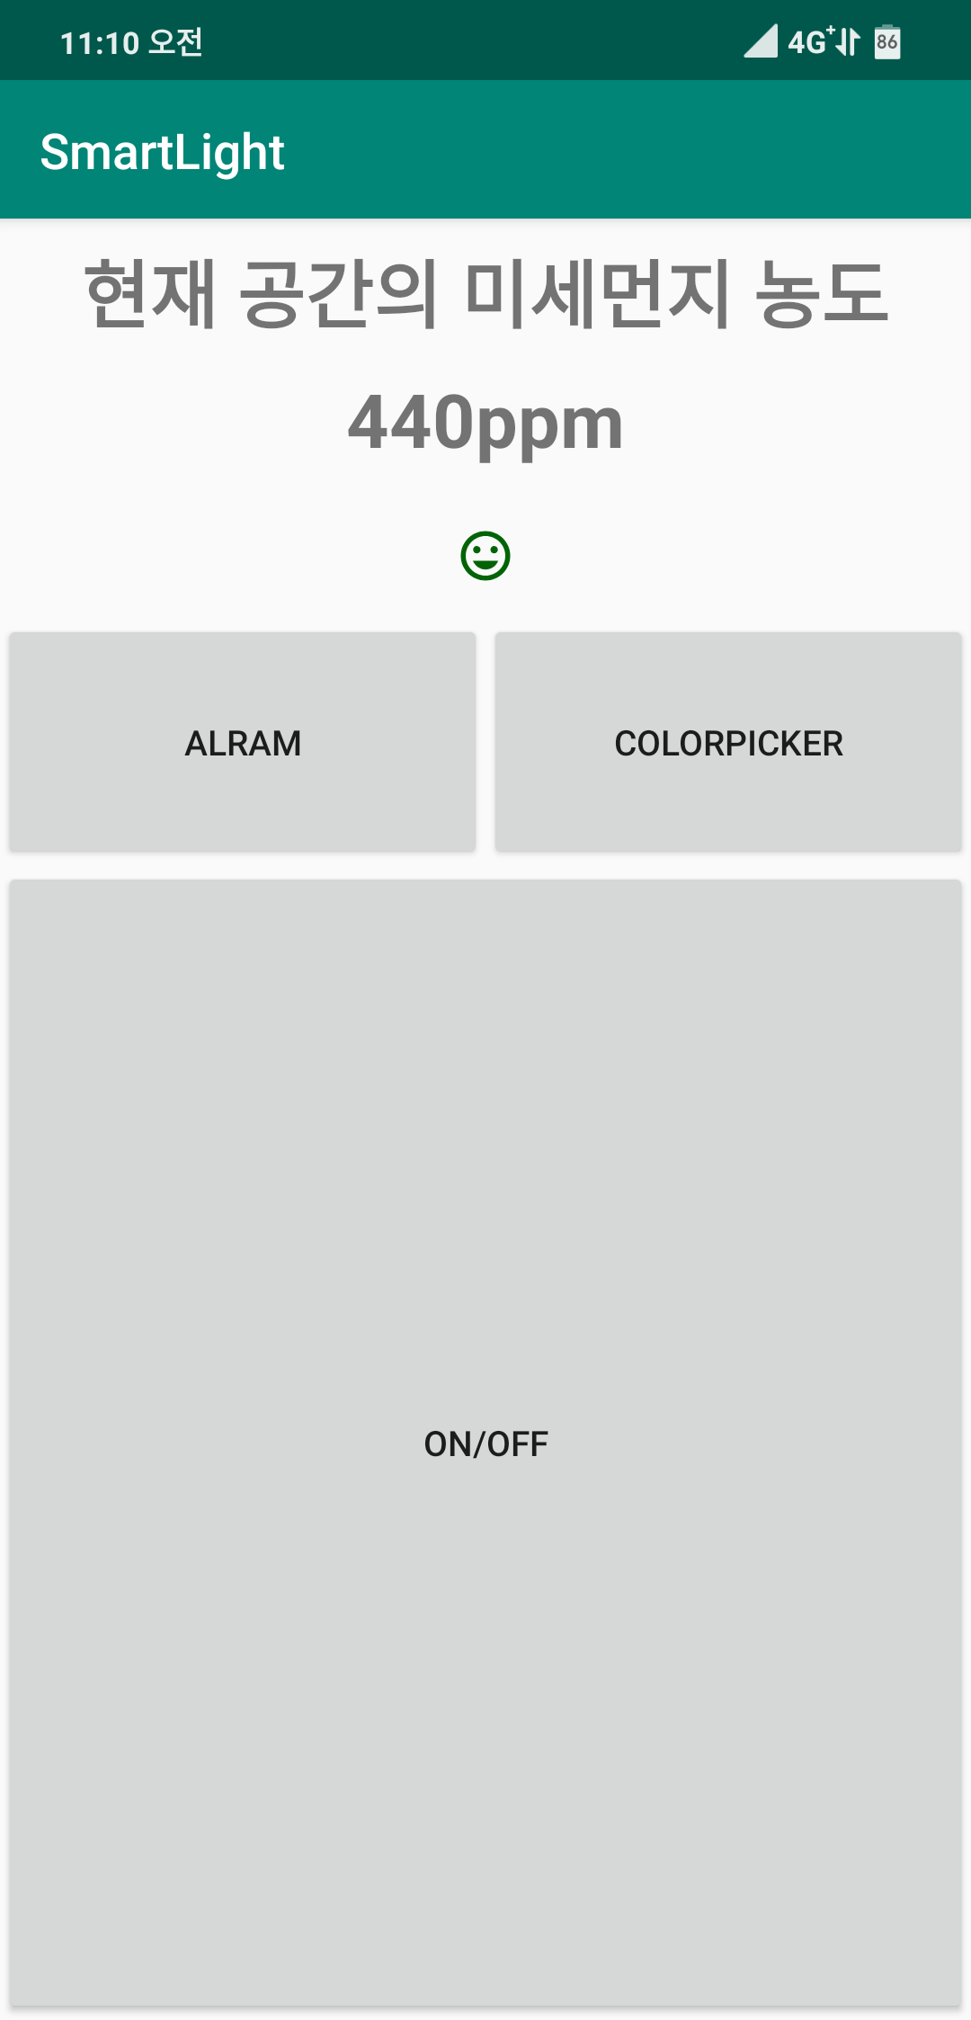
Components
IronMan MoodLight
Hardware
Bluetooth Module HC06(0ptional)
-Connecting smartphone, data transmission

Slide 17
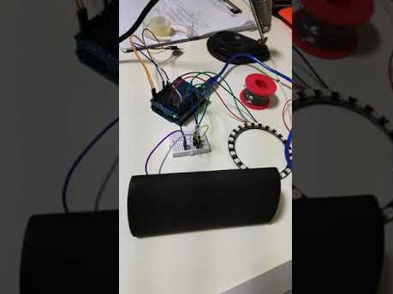
Components
IronMan MoodLight
Hardware
Speaker(Optional)
-Play Alarm Music

Slide 18
Important features
-
We don’t need to touch
Mood Light directly.
-
We can control
Mood Light by gesture.

Slide 19
Progress
BrainStorming (10/7)
Idea : Smart Mood Light
Code Sketch (10/13)
Wrote Fundamental system code
Tested basic components

Slide 20
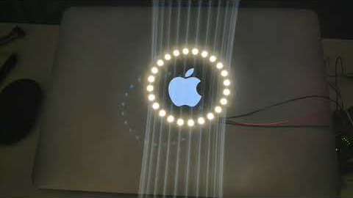
Progress
IronMan MoodLight
Sample

Slide 21
Progress
Make Hardware
11/2
Complete Code
11/9
Bug fix
11/16

Slide 22
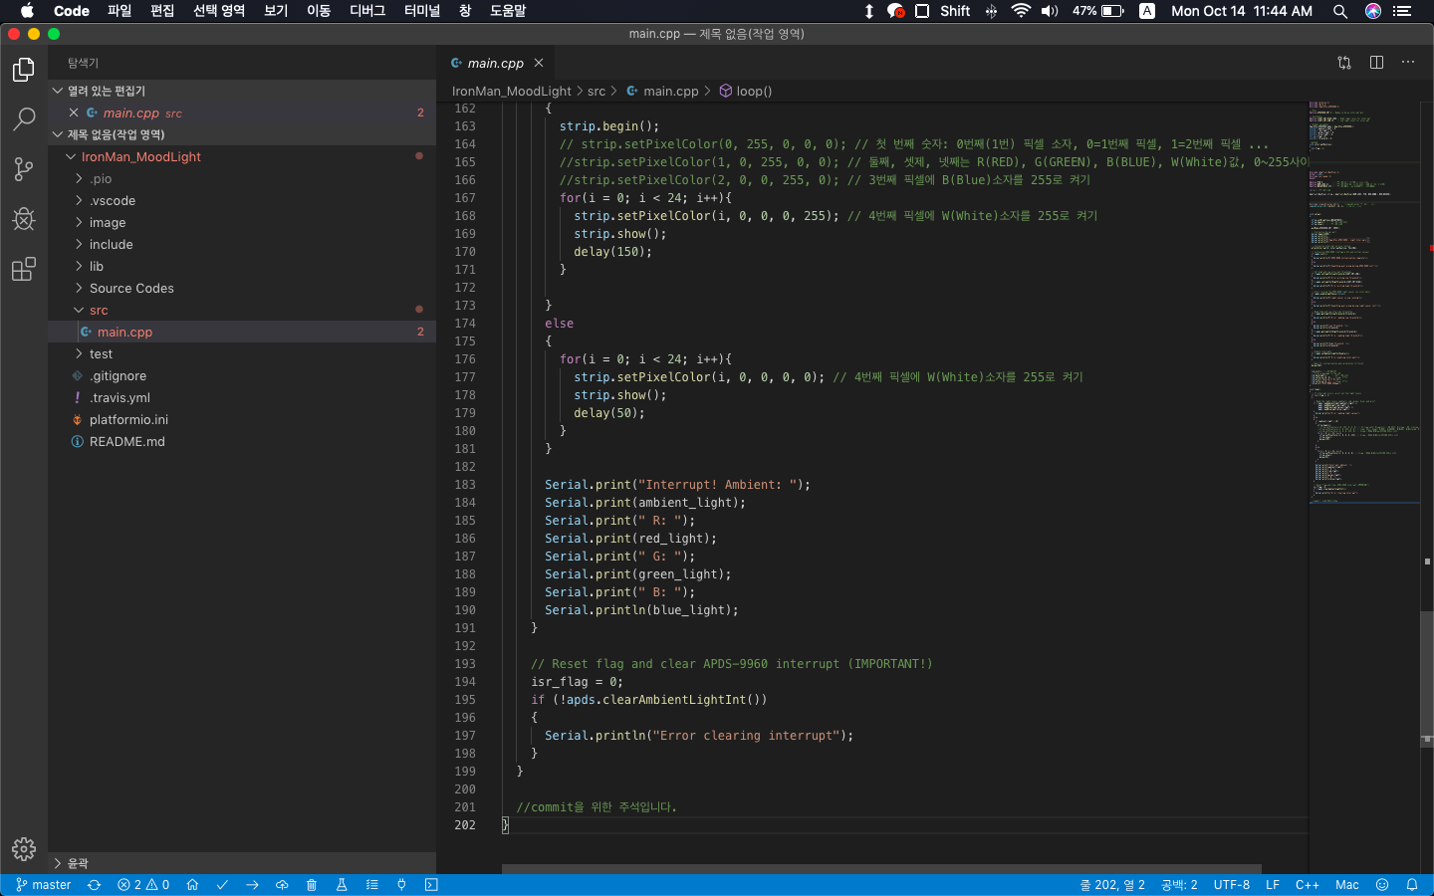
Progress
IronMan MoodLight
Code Sample

Slide 23
Role
Role
신재형
Basic Idea Sketch
Made basic structure of Codes
김주현
Design
3D printing
Neopixel handling
양재혁
Research LCD real time Clock
Two loop handling

Slide 24
THANK YOU
Team : 신과 함께
신재형, 김주현, 양재혁

